Slide 1

Discrete Mathematics
Unit-II
Dr. Amit Kumar Singh
Assistant Professor
Department of Applied Science

Slide 2
Applications of Set
Mathematics: Sets are fundamental in mathematics and are used in various mathematical operations and theories. They are used to define and study functions, relations, and mappings.
Set theory forms the foundation of other branches of mathematics, such as combinatory, probability theory, and discrete mathematics.

Slide 3
Database Management: Sets are used in database management to handle collections of unique items efficiently.
Computer Science: Sets are widely used in data structures like hash sets, trees, and graphs. It also play a crucial role in various algorithms, such as searching, sorting, and graph traversal.

Slide 4
Programming: Sets are used in programming languages to handle unique collections of items. Many programming languages provide built-in set data structures or support set operations to manipulate data effectively.
Cryptography: Sets are used in cryptographic algorithms for various purposes, such as creating unique keys and handling data securely. Set operations like union and intersection are employed in some encryption techniques.

Slide 5
Statistics: Sets are used in statistics to represent sample spaces, events, and probability distributions. Probability theory uses sets to model events and outcomes in experiments, and set operations are used to calculate probabilities.
Artificial Intelligence: Sets are used in AI and machine learning algorithms for tasks like data classification, clustering, and feature selection. Set theory concepts are applied in data preprocessing and analysis.

Slide 6
Set Theory
  Sets
  Combination of Sets
  Venn Diagram
  Finite and Infinite Sets
  Cardinality
  Principle of Inclusion and Exclusion

Slide 7



What is a set?
The theory of sets was developed by German mathematician Georg Cantor in 1874.
Definition:
A set is a well defined collection of objects.
These objects in a set are called the elements or members of the set. A set will be denoted by an upper case letters A, B, C,…, X, Y, Z. Elements will be denoted by lower case letters a, b, c, …, x, y, z.
For example: S={x, y, z} is a set. Here x is an element of the set S or x belongs to S, it is represented as . Similarly means that is not an element of S.

Slide 8
Other examples are
  People in a class: { Abhishek, Kunal, Chetna }
  Courses offered by a department: {EM-I, EM-II, DMPT, … }
  Colors of a rainbow: {violet, indigo, red, orange, yellow, green, blue }
  States of matter { solid, liquid, gas, plasma }
  Sets can contain non-related elements: { 3, a, red, DMPT}
Although a set can contain (almost) anything, we will most often use sets of numbers
  All positive numbers less than or equal to 5: {1, 2, 3, 4, 5}
  A few selected real numbers: { 2.1, π, 0, -6.32, e }
Order does not matter
  We often write them in order because it is easier for humans to understand it that way
  {1, 2, 3, 4, 5} is equivalent to {3, 5, 2, 4, 1}

Slide 9
Often used sets
N = {1, 2, 3, …} is the set of natural numbers
W = {0, 1, 2, 3, …} is the set of whole numbers
Z = {…, -2, -1, 0, 1, 2, …} is the set of integers
Z⁺ = {1, 2, 3, …} is the set of positive integers
Q = {p/q | p ∈ Z, q ∈ Z, q ≠ 0} is the set of rational numbers
  Any number that can be expressed as a fraction of two integers (where the bottom one is not zero)
  Q* is the set of nonzero rational numbers
R is the set of real numbers
R⁺ is the set of positive real numbers
R* is the set of nonzero real numbers
C is the set of complex numbers

Slide 10
Set properties
Sets do not have duplicate elements
  Consider the set of vowels in the alphabet.
    It makes no sense to list them as {a, a, a, e, i, o, o, o, o, o, u}
    What we really want is just {a, e, i, o, u}
Note that a list is like a set, but order does matter and duplicate elements are allowed
  We won’t be studying lists much in this class
Sets can contain other sets
  S = { {1}, {2}, {3} }
  T = { {1}, {{2}}, {{{3}}} }
  V = { {{1}, {{2}}}, {{{3}}}, { {1}, {{2}}, {{{3}}} } }
Note that 1 ≠ {1} ≠ {{1}} ≠ {{{1}}}
  They are all different

Slide 11
Representation of a Set
Mainly there are two ways of representing a set.
Roster or Tabular Form: In this form all the elements or members of the set are listed and being separated by commas and are enclosed in braces {}.
For example:
(i) The set of odd positive integers less than 12 can be written as:
S={1,3,5,7,9,11}.
(ii) The set of all vowels in English alphabet can be written as :
S={a, e, i, o, u}.

Slide 12
To be cont….
2. Set Builder Form: We define the elements of the set by specifying a property that they have in common.
For example:
(i) The set S consisting of elements a, e, i, o, u can be written as:
S={x | x is a vowel in the English alphabets}.
(ii) The set S={1, 4, 9, 16, 25} can be written as :
S={ x | x=n² , where n is a natural number < 5}.

Slide 13
Types of Sets
Empty Set or Null Set: A set with no element is called an empty set or null set or void set and is denoted by ∅ = { }.
For example:
(i) {x | x is a real number satisfying x² =-5}= ∅.
(ii) {x | x is an integer satisfying 3x+5 =6}= ∅.
Singleton Set: A set consisting of a single elements is called a singleton set.
For example:
(i) S={3}
(ii) {x | 1<x<3 and x ∈ N}={2}

Slide 14
To be cont….
Finite sets: A set witch contains a finite number of elements is called a finite set.
  Examples:
    A = {1, 2, 3, 4}
    B = {x | x is an integer, 1 < x < 4}
    The set of students in a class.
Infinite sets: A set witch contains an infinite number of elements is called an infinite set
  Examples:
    Z = {x | x is an integer} = {…, -3, -2, -1, 0, 1, 2, 3,…}
    S={x | x is a real number and 1 < x < 4} = {1, 1.1. 1.2,….,4}

Slide 15
To be cont….
Universal set: The set which contains all the objects or elements under consideration is called universal set and denoted as U.
  For the set {-2, 0.4, 2}, U would be the real numbers
  For the set {0, 1, 2}, U could be the whole numbers (zero and up), the integers, the rational numbers, or the real numbers, depending on the context
  For the set of the vowels of the alphabet, U would be all the letters of the alphabet.

Slide 16
Equality or Equal Set
Two sets are equal if they have the same elements
  {1, 2, 3, 4, 5} = {5, 4, 3, 2, 1}
    Remember that order does not matter!
Two sets are not equal if they do not have the same elements
  {1, 2, 3, 4, 5} ≠ {1, 2, 3, 4}

Slide 17


Subset
Let S and T are two sets and all the elements of a set S are also elements of a set T then S is a subset of T.
  For example, if S = {2, 4, 6} and T = {1, 2, 3, 4, 5, 6, 7}, then S is a subset of T
  This is specified by S T
    Or by {2, 4, 6} {1, 2, 3, 4, 5, 6, 7}
If S is not a subset of T, it is written as such:
S T
For example, {1, 2, 8} {1, 2, 3, 4, 5, 6, 7}
Remark:
  Every set is a subset of itself.
  The empty set is a subset of all sets

Slide 18
To be cont….
  If a set contain n-elements then the number of subset is 2^{n}.
  For example:
  S = {a, b, c} so that S has 2³ =8 subsets, which are
  ∅, {a}, {b}, {c}, {a, b}, {b, c}, {a, c}, {a, b, c}.

Slide 19
Proper Subset
Let S and T be two sets. The set S is called the proper subset of T if and only if every element of S is the element of T and there is at least one element of T which is not an element of the set S i.e., : S ⊂ T but S≠T.
For example:
  Let T = {0, 1, 2, 3, 4, 5} and S = {1, 2, 3}, S is not equal to T, and S is a subset of T
  Let R = {0, 1, 2, 3, 4, 5}. R is equal to T, and thus is a subset (but not a proper subset) or T
    Can be written as: R ⊆ T .
    Let Q = {4, 5, 6}. Q is neither a subset or T nor a proper subset of T.

Slide 20
Power set
If S is a set, then power set of S is the set of all subsets of the set S. It is denoted by P(S).
For example:
Let S = {0, 1, 2}. The P(S) = { ∅, {0}, {1}, {2}, {0,1}, {0,2}, {1,2}, {0,1,2} }
    Note that |S| = 3 and |P(S)| = 8
P(∅) = { ∅ }
    Note that |∅| = 0 and |P(∅)| = 1
If a set has n elements, then the power set will have 2^{n} elements
If |A|=n, then |P(A)|=2^{n}.

Slide 21
Venn diagram
Set can be represented graphically by means of Venn diagrams in which the universal set is represented by the interior of a rectangle and other sets are represented by the interior of circles that lie inside the rectangle.
Represents sets graphically
  The box represents the universal set
  Circles represent the set(s)
  Consider set S, which is the set of all
  vowels in the alphabet
b
c
d
f
U
g
h
j
S
k
l
m
n
p
q
a
e
i
r
s
t
o
u
v
w
x
y
z

Slide 22
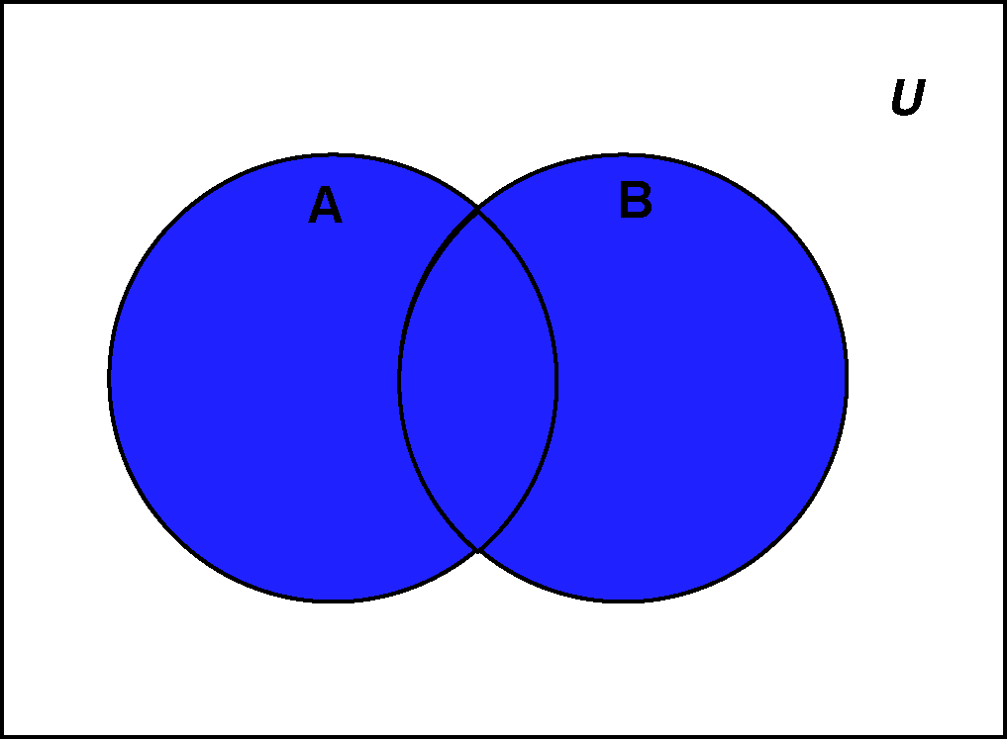
Operations on Sets:
Union of Two Sets: Let A and B be two sets then the union of two sets A and B is denoted by AUB is the set of elements which are in A or in B or in both, i.e.
A U B = { x | x ∈ A or x ∈ B }
Example: Let A={1, 2, 3, 4, 5, 6} and B={5, 7, 4, 3, 9} then
AUB ={1, 2, 3, 4, 5, 6, 7, 9}.

Slide 23
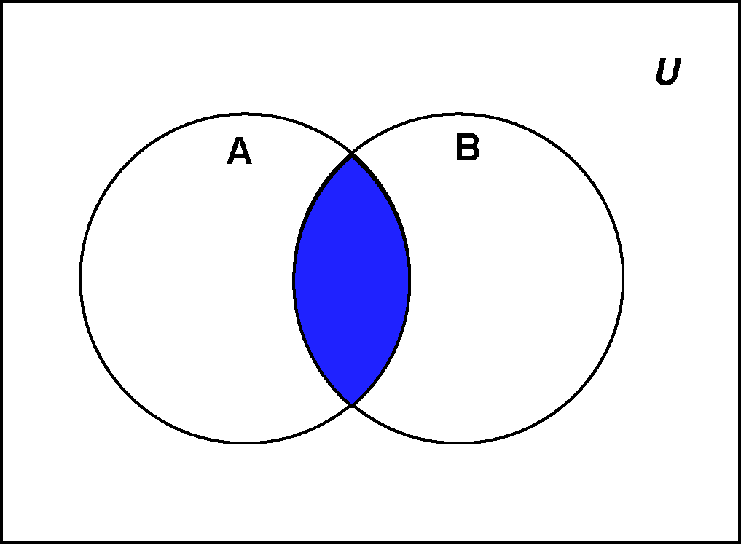
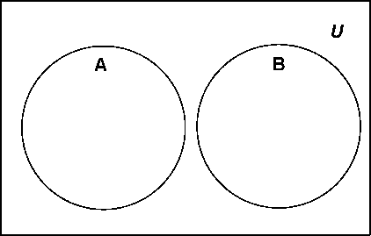
To be Cont….
Intersection of Two Sets: The intersection of two sets A and B, denoted by A ∩B, is the set of elements that belongs to both A and B. i.e. A ∩ B = { x | x ∈ A and x ∈ B}
Example: Let A={1, 2, 3, 4, 5, 6}
and B={5, 7, 4, 3, 9} then
A ∩ B ={3, 4, 5}.
Disjoint Set: If A and B do not have any
element in common, then the sets A and B are said to be disjoint.
i.e. A ∩ B = ∅
Example: Let A={1, 2, 3, 4} and B={5, 7, 9} then
A ∩ B = ∅

Slide 24
To be Cont….
examples
  {1, 2, 3} U {3, 4, 5} = {1, 2, 3, 4, 5}
  {New York, Washington} U {3, 4} = {New York, Washington, 3, 4}
  {1, 2} U ∅ = {1, 2}
  {1, 2, 3} ∩ {3, 4, 5} = {3}
  {1, 2, 3} and {3, 4, 5} are not disjoint
  {New York, Washington} ∩ {3, 4} = ∅
    No elements in common, these sets are disjoint
  {1, 2} ∩ ∅ = ∅
    Any set intersection with the empty set yields the empty set

Slide 25



To be Cont….
Complement: If U is the universal set and A is any set, then the set of elements which belong to U but which do not belong to A is called the complement of A and is denoted by Aʹ or
i.e. Aʹ = { x | x ∈ U and x ∉ A }
Relative complement or difference of Two Sets: If A and B are any two sets, then the set of elements that belongs to A but do not belong to B is called the difference of A and B or relative complement of B with respect to A and is denoted by A-B or A\B.

Slide 26
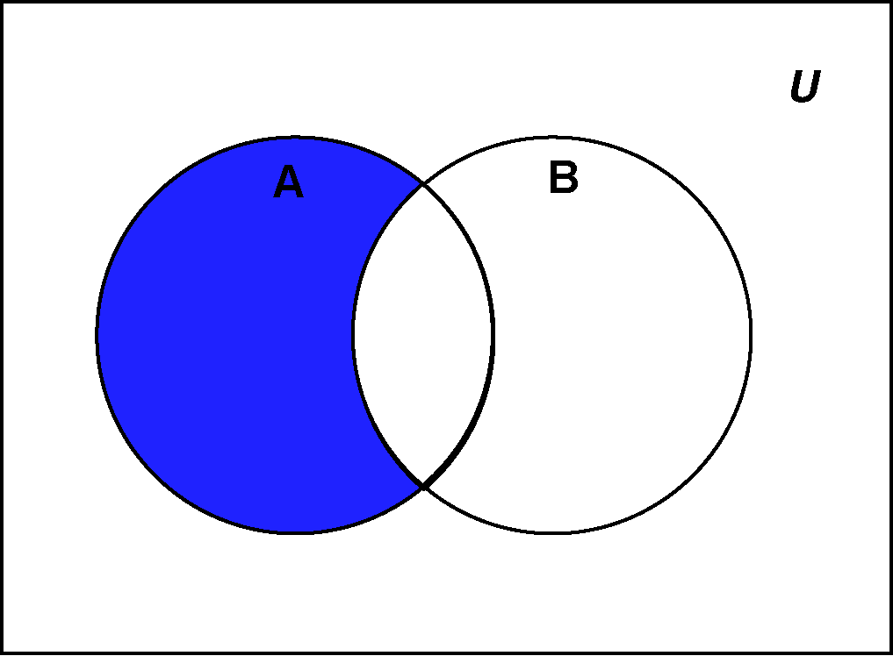
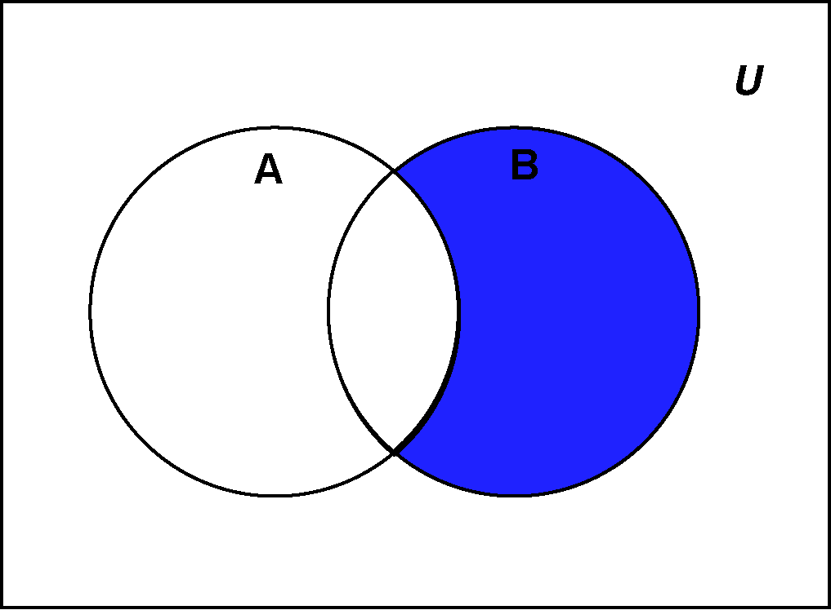
To be Cont…..
i.e. A — B = { x | x ∈ A and x ∉ B }
Example: Let A = {a, b, c, d} and
B = {a, c, f, g}
A — B = {b, d} B — A = {f, g}
A-B
B-A

Slide 27
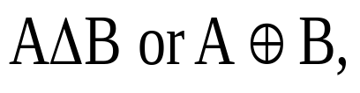
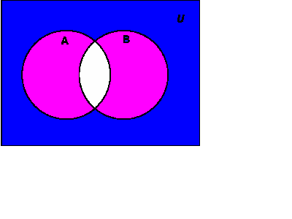

Set Operations: Symmetric Difference
Definition:
The symmetric Difference of sets A and B, denoted
consists of those elements which belong to A or B but not to both.
i.e.
A Δ B = { x | (x ∈ A or x ∈ B) and x ∉ A ∩ B}
A Δ B = (A U B) – (A ∩ B) ← Important!
Note that the pink region is the required
symmetric difference
If A = {1,2,3} and B = {2,5,6,7}
Then
= { 1,3,5,6,7}

Slide 28
Set operations: Complement and symmetric difference
examples
  {1, 2, 3} - {3, 4, 5} = {1, 2}
  {New York, Washington} - {3, 4} = {New York, Washington}
  {1, 2} - ∅ = {1, 2}
  The difference of any set S with the empty set will be the set
(assuming U = Z)
  Complement of {1, 2, 3} = { …, -2, -1, 0, 4, 5, 6, … }
  {1, 2, 3} Δ {3, 4, 5} = {1, 2, 4, 5}
  {New York, Washington} Δ {3, 4} = {New York, Washington, 3, 4}
  {1, 2} Δ ∅ = {1, 2}
    The symmetric difference of any set S with the empty set will be the set S

Slide 29
Proper subsets: Venn diagram
What is the meaning of S ⊆ R and S≠ R ?
S is a proper subset of R
S ⊂ R
U
R
S

Slide 30
Example
If X={1, 4, 7, 10}, Y={1, 2, 3, 4, 5}
  X ∪ Y = {1, 2, 3, 4, 5, 7, 10}
  X ∩ Y = {1, 4}
  X – Y = {7, 10}
  Y – X = {2, 3, 5}
  X Δ Y = (X ∪ Y) – (X ∩ Y) = {2, 3, 5, 7, 10}

Slide 31
Properties of Set operations
Properties of the union operation
  A U ∅ = A Identity law
  A U U = U Domination law
  A U A = A Idempotent law
  A U B = B U A Commutative law
  A U (B U C) = (A U B) U C Associative law
Properties of the intersection operation
  A ∩ U = A Identity law
  A ∩ ∅ = ∅ Domination law
  A ∩ A = A Idempotent law
  A ∩ B = B ∩ A Commutative law
  A ∩ (B ∩ C) = (A ∩ B) ∩ C Associative law

Slide 32
Properties cont…
Properties of complement sets
  A= A Complementation law
  A U A = U Complement law
  A ∩ A = ∅ Complement law
¯
¯
¯
¯

Slide 33
Properties of set operations
Theorem : Let U be a universal set, and A, B and C subsets of U. The following properties hold:
a) Associativity: (A ∪ B) ∪ C = A ∪ (B ∪ C)
(A ∩ B) ∩ C = A ∩ (B ∩C)
b) Commutativity: A ∪ B = B ∪ A
A ∩ B = B ∩ A
c) Distributive laws:
A∪(B∩C) = (A∪B)∩(A∪C)
A∩(B∪C) = (A∩B)∪(A∩C)
d) Identity laws:
A∩U=A A∪∅ = A

Slide 34
Properties cont…
e) Complement laws:
A∪A^{c} = U A∩A^{c} = ∅
f) Idempotent laws:
A∪A = A A∩A = A
g) Bound laws:
A∪U = U A∩∅ = ∅
h) Absorption laws:
A∪(A∩B) = A A∩(A∪B) = A

Slide 35
Properties cont…
i) Involution law: (A^{c})^{c} = A
j) De Morgan’s laws for sets:
(A∪B)^{c} = A^{c}∩B^{c}
(A∩B)^{c} = A^{c}∪B^{c}

Slide 36
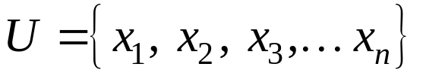
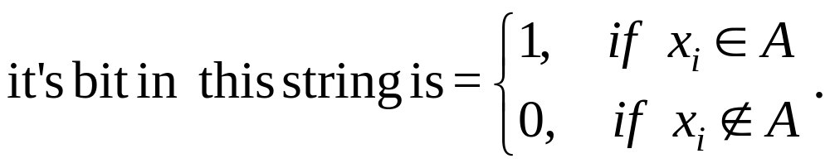
Computer representation of sets
When a universal set U is finite Say
then all subset U can be represented with the bit string of length n.
A bit string is a string over the alphabet {0,1}. If A is a subset of U then A is represented by bit string of length n.
Example.1: If U={1, 2, 3, 4, 5, 6}, A={1, 2, 3, 4} and B={3, 4, 5, 6} then find the bit string for the set A & B. Use bit string to find A', union and intersection of A & B.

Slide 37
To be cont…
Solution:
U={1, 2, 3, 4, 5, 6}
Length of the bit string is 6
A={1, 2, 3, 4}, B={3, 4, 5, 6}
The representation of A and B are 111100, 001111
A ∪B= 111100 ∪001111=111111={1, 2, 3, 4, 5, 6}
A ∩ B= 111100 ∩ 001111=001100={3, 4}
A' =000011= {5, 6}.

Slide 38
To be cont…
  Example .2 : Let U be the alphabet i.e. set of letters and set A and B represents the set of vowels in the alphabet and consonants in the alphabet respectively. Use bit string to find the union and intersection of sets A and B.
Solution: Bit string for the universal set
U={11111111111111111111111111}
A=The vowels in the alphabet:
abcdefghijklmnopqrstuvwxyz
10001000100000100000100000
B=The consonants in the alphabet:
abcdefghijklmnopqrstuvwxyz
01110111011111011111011111

Slide 39
Computer representation of set
A ∪ B= 10001000100000100000100000
    ∪ 01110111011111011111011111
    A ∪ B= 11111111111111111111111111
A∩B = 10001000100000100000100000
    ∩ 01110111011111011111011111
    A∩B = 00000000000000000000000000

Slide 40
Cardinality
Definition: If S be a set, then the number of elements present in the set S is known as cardinality of S. It is denoted by |S|.
Examples:
  If A = {1, 2, 3} then |A| = 3
  If B = {x | x is a natural number and 1< x< 9}
  then |B| = 9
Example of Infinite cardinality
  Set of natural numbers, N={1, 2, 3, ………}.
  Set of integer numbers, Z ={…, -2, -1, 0, 1, 2, …}.

Slide 41
Principle of Inclusion and Exclusion
(1) If A and B are finite set then
| A ∪ B |= | A |+ | B |- | A ∩ B |
or n(A ∪ B )= n(A )+ n( B )- n(A ∩ B )
(2) If A and B are disjoint finite set then
| A ∪ B |= | A |+ | B |
or n(A ∪ B )= n(A )+ n( B)
(3) | A -B |= | A |- | A ∩ B |
(4) | B -A |= | B |- | A ∩ B |
(5) If A, B and C are finite set then
|A ∪ B ∪ C |= |A|+ |B|+ |C|-|A ∩ B|-|B ∩ C|- | A ∩ C |+ |A ∩ B ∩ C|.

Slide 42
Problems
Two finite sets have m and n elements respectively. The total number of subsets of first set is 56 more than the total number of subsets of the second set. Find the values of m and n.
If X = {8^n – 7n – 1 | n ∈ N} and Y = {49n – 49 | n ∈ N}. Then
(A) X ⊂ Y (B) Y ⊂ X (C) X = Y (D) X ∩ Y = φ

Slide 43
Solution
1. A and B be such sets,
i.e., n (A) = m, n (B) =n
So n (P(A)) =2^m, n (P(B)) = 2^n
Thus n (P(A)) – n (P(B)) =56,
i.e., 2^m – 2^n = 56
⇒ 2^n (2^(m – n )– 1) =2^3 .7
⇒ n =3 ,
2^(m – n) – 1 = 7
⇒ m =6

Slide 44
Examples
Example.1: A computer company receives 350 applications from computer graduates for a job planning a line of new Web servers. Suppose that 220 of these people majored in computer science, 147 majored in business, and 51majored both in computer science and in business. How many of these applicants majored neither in computer science nor in business?
Solution: Let A be the set of students who majored in computer science and B the set of students who majored in business. Then we have , | A |=220, | B |=147, |A ∩B |= 51
By the principle of inclusion and exclusion:
The number of students who majored either in computer science or in business, | A ∪ B |= | A |+ | B |- | A ∩ B |

Slide 45
To be Cont…..
| A ∪ B |= 220+147-51=316
The number of applicants who majored neither in computer science nor in business=350-316=34.
Example. 2: If A and B be two sets containing 3 and 6 elements respectively, what can be the minimum number of elements in A ∪ B ? Find also, the maximum number of elements in A ∪ B .
Solution: Given | A |=3 , | B |=6
By the principle of inclusion and exclusion:
| A ∪ B |= | A |+ | B |- | A ∩ B | (1)
Case (i): When | A ∩ B | is minimum i.e., | A ∩ B | =0.
Hence Eq (1) becomes: | A ∪ B |= 3+6-0=9
⸫ maximum number of elements in A ∪ B is 9.

Slide 46
To be Cont…..
Case (ii): When | A ∩ B | is maximum i.e., | A ∩ B | =3.
Hence Eq (1) becomes: | A ∪ B |= 3+6-3=6
⸫ minimum number of elements in A ∪ B is 6.
Example.3: If A and B are two sets and U is universal set such that |U|= 700, | A |=200 , | B |=300 and |A ∩ B| =100. Find |A' ∩ B'| .
Solution: |A' ∩ B'| = |(A ∪ B )'|= |U|- |A ∪ B|
= |U|- {| A |+| B |- |A ∩ B|}
= 700- {200+300- 100} =300.

Slide 47
To be Cont…..
Example.4: If a survey of 110 students it was found that 50 used the college library, 40 had their own library and 30 borrowed books, of these 20 used both the college library and their own, 15 used their own and borrowed books and 10 used the college library and borrowed books. How many students used all the three sources of books?

Slide 48
To be Cont…..
Solution: Let A: Students using the college library
B: Students using the their own library
C: Students using the borrow books
Given, | A |=50, |B |= 40, |C |= 30, | A ∩ B | =20, |B ∩ C| =15,
| A ∩ C | =10, |A ∪ B ∪ C |= 110.
By the principle of inclusion and exclusion:
|A∪ B∪C|= |A|+ |B|+ |C|-|A ∩ B|-|B ∩ C|- |A ∩ C |+ |A∩B ∩ C|
110=50+40+30-20-15-10 + |A∩B ∩ C|
|A∩B ∩ C|=35.
Therefore the 35 students used all the three sources of books.

Slide 49
To be Cont…..
Example. 5: Among 100 students, 32 study Mathematics, 20 study Physics, 45 study Chemistry, 15 study Mathematics and Chemistry, 7 study Mathematics and Physics, 10 study Physics and Chemistry and 30 do not study any of the three subjects.
Find the no. of student studying all the three subjects.
Find the no. student studying exactly one of the three subjects.
Solution: Let X denotes the set of all students in the class. Let M, P, and C denotes the set of students studying Mathematics, Physics and Chemistry respectively, then we have,
|X|=100, |M|=32, |P|=20, |C|=45, |M∩C| =15, |M∩ P| =7,
|P∩ C| =10, |(M ∪ P ∪ C)' |= 30.

Slide 50
To be Cont…..
| |M ∪ P ∪ C|=|X|-|(M ∪ P ∪ C)'|=100-30=70
(i) By the principle of inclusion and exclusion:
|M∪P∪C|= |M|+ |P|+ |C|-|M ∩ P|-|P ∩ C|- |M ∩ C |+ |M∩P ∩ C|
70=32+20+45-7-10-15 + | M∩P ∩ C |
| M∩P ∩ C |=5.
(ii) Let M₁, P₁, and C₁ be the set of students who studying only Mathematics, Physics and Chemistry respectively.
Therefore M₁=M-P-C, P₁=P-M-C, C₁ =C-M-P
The number of students who study only Mathematics:
| M₁|= |M-P-C|= |M|- |M ∩ P|- |M ∩ C|+ |M∩P ∩ C|
=32-7-15+5=15

Slide 51
To be Cont…..
The number of students who study only Physics :
| P₁ |= | P-M-C |= |P|- |P ∩ M|- |P ∩ C|+ |M∩P ∩ C|
=20-7-10+5=8
The number of students who study only Chemistry :
| C₁|= |C-M-P|= |C|- |C ∩ M|- |C ∩ P|+ |M∩P ∩ C|
=45-15-10+5=25
Hence the number of students who study exactly one out of three:
= | M₁ |+ | P₁ |+ | C₁ |=15+8+25=48.

Slide 52
To be Cont…..
Example. 6: In the CSI conference held at SIT Pune, 500 delegates attended. 200 of them could take tea, 350 could take coffee and 10 did not take either coffee or tea. Then answer the following questions.
How many can take both tea and coffee.
How many can take tea only and
How many can tale coffee only.
Solution: Let T: Set of persons who take tea.
C: Set of persons who take coffee.
U: Total number of delegates.
Hence , n(U)=500, n(T)=200, n(C)=350
Number of delegates did not take either coffee or tea=10

Slide 53
To be Cont…..
Therefore number of delegates who take either coffee or tea
= 500-10=490, i.e. n(T ∪C)=490.
By the principle of inclusion and exclusion:
n(T ∪ C) = n(T) + n(C) - n(T ∩ C)
490=200+350- n(T ∩ C)
n(T ∩ C)=200+350-490=60
So, the number of persons who take both coffee and tea
i.e. n(T ∩ C)=60
The number of persons take tea only, n(T -C)= n(T) - n(T ∩ C)
n(T -C)= 200 – 60= 140
The number of persons take coffee only, n(C-T)= n(C) - n(T ∩ C)
n(C-T)= 350 – 60= 290.

Slide 54
To be Cont…..
Example. 7: If 65% of students like apples where 75% like grapes then what percentage of students likes both apples and grapes?
Solution: Total number of students = 100
n(A): Total number of students who like apples = 65
n(B): Total number of students who like grapes = 75
By the principle of inclusion and exclusion:
n(A ∪ B) = n(A) + n(B) - n(A ∩ B)
100=65+75- n(A ∩ B)
n(A ∩ B)=40.
So, 40% of students like both apples and grapes.

Slide 55
To be Cont…..
Example. 8: In a group of 191 students, 10 are taking English, Commuter Science and Music; 36 are taking English and Computer Science; 20 are taking English and Music; 18 are taking Computer Science and Music; 65 are taking English; 76 are taking Computer Science and 63 are taking Music. Then Find the followings
How many are taking English and Music but not Computer Science.
How many are taking Computer Science and Music but not English.
How many are taking Computer Science and neither English nor Music.
How many are taking none of three subjects.

Slide 56
To be Cont…..
Solution: Let S: Set of students
E: Set of students taking English
C: Set of students taking Computer Science
M: Set of students taking Music
Given that , n(S)=191; n(E)=65; n(C)=76; n(M)=63;
n(E∩C ∩ M)=10; n(E∩C )=36; n(E∩M )=20; n(C∩M )=18
Number of students taking English and Music but not Computer Science = n(E∩M )- n(E∩C ∩ M)=20-10=10
Number of students taking Computer Science and Music but not English= n(C∩M )- n(E∩C ∩ M)=18-10=8
Number of students taking Computer Science and neither English nor Music= n(C )- n(E∩C)- n(C∩ M)+n(E∩C ∩ M)

Slide 57
To be Cont…..
=76-36-18+10
=32
(iv) Number of students taking none of the three subjects
= n(E ∪ C ∪ M ) ͨ
=n(S) - n(E ∪ C ∪ M )
= n(S) –[ n(E) + n(C)+ n(M) - n(E ∩ C)
-n( C ∩ M)- -n( E ∩ M)+ n(E∩C ∩ M )]
=191-[65+63+76-20-36-18+10]
=51.

Slide 58
Practice Problems
Q.1: In a group of 64 students 26 can speak Hindi only, 14 can speak English only. How many can speak both Hindi and English.
Ans: 24.
Q.2: In a survey about liking for colours, it was found that everyone who was surveyed had a liking for at least one of the three colours namely Red, Green and Blue. Further 30% liked Red; 40% liked Green and 50% liked Blue. Further 10% people liked both Red and Green, 5% liked both Green and Blue and 10% liked both Red and Blue. Find the percentage of the surveyed people who like all the colours.
Ans: 5%.

Slide 59
Recommended Books
Chung Laung Liu, Elements of Discrete Mathematics, McGraw Hill Education India, 2008.
S. C. Gupta and V. K. Kapoor, Fundamentals of Mathematical Statistics, Sultan Chand & Sons, 2020.
Kenneth H. Rosen, Discrete Mathematics and Its Applications, McGraw-Hill Education, 2012.

Slide 60

Any Questions ???

